Slide 1
How to conduct research: A glimpse into some aspects
ZHENG Yaozhi

Slide 2
Contents:
Research procedures
How to get started in a new field
How to read papers
Miscellaneous
……
FYI, the contents on this PPT are totally ‘stolen’ from the Internet :D

Slide 3
Research Procedures
Select a topic
Literature review
Identifying the weakness of the existing methods
Reproducing the existing methods, if necessary
Proposing new methods*
Implementing your methods*
Debugging*
Writing the paper
Presenting your work
Identifying new research project
Notes:
这是一个循环。
最后一项识别新的研究项目可以这么理解：一方面，可以是针对自己当前项目的批判性的思考，从项目的不足出发进行改进。另一方面也可以是全新的项目。

Slide 4
How to get started in a new field
Survey papers: Basics
Reference papers: Depth
Updates of top journal in the field: Frontier
Knowledge structure
Resources:
Papers
Google scholar, arXiv, Sci-hub, …
Textbooks
Courses
MIT, Coursera, MOOC, …
Videos
Youtube, bilibili, …
Various ways, but which one is the fastest? Which one is the most suitable?
Maybe you should have a try first ._.

Slide 5
Structure of a paper
Example: Attention is all you need
Abstract
Introduction
Background
Model Architecture
Why Self-Attention
Training
Results
Conclusion
https://arxiv.org/abs/1706.03762
Title
Abstract
Introduction
Related works
Methods
Experiments
Conclusion

Slide 6
How to read papers
3 Steps:
Step 1: Title, Abs, Intro
Also pay attention to important graphs, forms to get the picture
Step 2: Skim through whole paper
Understand the whole logic
Understand the functions of each part
Step3: Delve into the paper
Criticize while reading

Slide 7
How to read papers
What to expect:
Related works?
Purpose?
What’s new? Innovation?
How?
What has been achieved?
What is left? Any improvements?

Slide 8
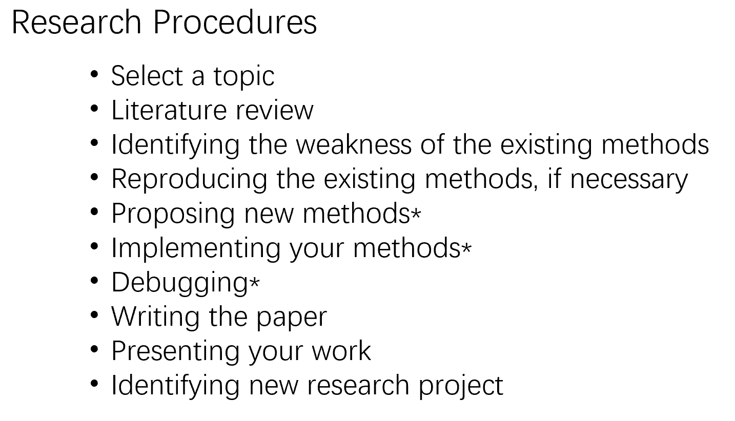
Miscellaneous
What abilities are required:
Reading and comprehension
Logic reasoning
Programming
Trouble shooting
Teamwork, Leadership
Writing
Presentation skills
Vision
……

Slide 9
Miscellaneous
Possible obstacles:
Distractions and temptations
Incapacities
Loss of motivations
Communication problems
Pressure
Anxiety
Not willing to collaborate
……

Slide 10
Stolen from
bilibili, XHS
Internet
Google Scholar
arXiv
github

Slide 11
Thank you!
Q & A
Comments

Slide 12
My resolutions
Openness
Communication
Willing to learn
Humble attitude
……

Slide 13
Questions
参考文献：
https://github.com/zibuyu/research_tao/blob/master/02_reading_paper.md
研究生如何科研-B站最实用的科研方法(计算机专业)_哔哩哔哩_bilibili
http://www.lib.seu.edu.cn/list.php?fid=49
基本上这些是比较好的，其余的有的只有一些可取或者大量重复，PPT中会覆盖到的

Slide 14
Comments

